Slide 1
TechWorkshop L300: Azure AI Apps and Agents
Day 2
Notes:
Speaker notes:
Welcome to TechWorkshop L300: Azure AI Apps and Agents
Day 2

Slide 2
Workshop agenda day two
Start | Duration | Session | Mode
09:00 | 10 | Day two welcome and day one review | General
09:10 | 30 | Challenges and multi-agent orchestration | General
09:40 | 10 | Intro to lab exercises three through six | General
09:50 | 40 | Exercise three: Extend the shopping assistant using the A2A protocol | Teams
10:30 | 60 | Exercise four: Observe model utilization in Microsoft Foundry | Teams
11:30 | 10 | Debrief on exercises three and four | Teams
11:40 | 45 | Break
12:25 | 60 | Exercise five: Agentic DevOps | Teams
13:25 | 40 | Exercise six: AI-enhanced red teaming | Teams
14:05 | 10 | Debrief on exercises five and six | Teams
14:15 | 15 | Course wrap-up | General
Notes:
<Coach> Review the Day 2 agenda with students

Slide 3
Remaining questions

Slide 4
Challenges in development with AI agents
Notes:
<Coach>: In this section, we’ll review the challenges customers face when developing AI agents and the Microsoft answer to these challenges.

Slide 5
Successful AI agents development
Successfully developing AI agents requires 4 primary considerations
Provide agents with the right context
Ensure they only have access to what they should
Knowledge
Actions
Security
Evaluation
Give them the tools to complete their tasks
Ensure they complete their tasks correctly
Notes:
Speaker notes: When developing AI agents, there are four critical considerations that must be addressed for success: Knowledge, Actions, Security, and Evaluation. First, providing agents with the right context or knowledge ensures they understand the environment they operate in. Second, equipping them with the right tools and capabilities enables them to do the necessary tasks. Security is paramount—agents must have access only to the resources they need and be protected against misuse. Lastly, evaluation ensures the tasks are completed correctly and allows for performance optimization. Addressing these areas forms the foundation for effective AI agents.
Source: Azure AI Agent Service L300 Pitch Deck (link not available)

Slide 6
Develop performant, secure AI agents
Organizations need platforms that enable rapid development of performant, secure AI Agents
Current frameworks
What’s needed
Lack of integrated tools, insecure data grounding, challenging orchestration
Connected complex workflow automation grounded by seamless connection to enterprise data
Ineffective deployment of AI across websites, applications, and production environments
Tools and APIs that seamlessly integrate across enterprise applications
Flexible models that enable processing and integration of information from multiple modalities or types of data
Restrictive pre-defined models that are challenging to customize
Secure, responsible AI that protects sensitive information and behaves compliantly
Security and data privacy risks
Notes:
Speaker notes: Organizations today are facing challenges in developing AI agents because of the limitations of current frameworks. These limitations include a lack of integrated tools, security risks, and challenges in orchestrating complex workflows. What’s truly needed is a platform that connects complex workflow automation to enterprise data and seamlessly integrates with existing tools and applications. Flexible models must enable the processing of multiple types of data and modalities, and security must be built in to ensure compliance and data protection. The need is clear: organizations require platforms that make it easier to build and deploy scalable, secure AI agents rapidly.
Source: Azure AI Agent Service L300 Pitch Deck (link not available)

Slide 7

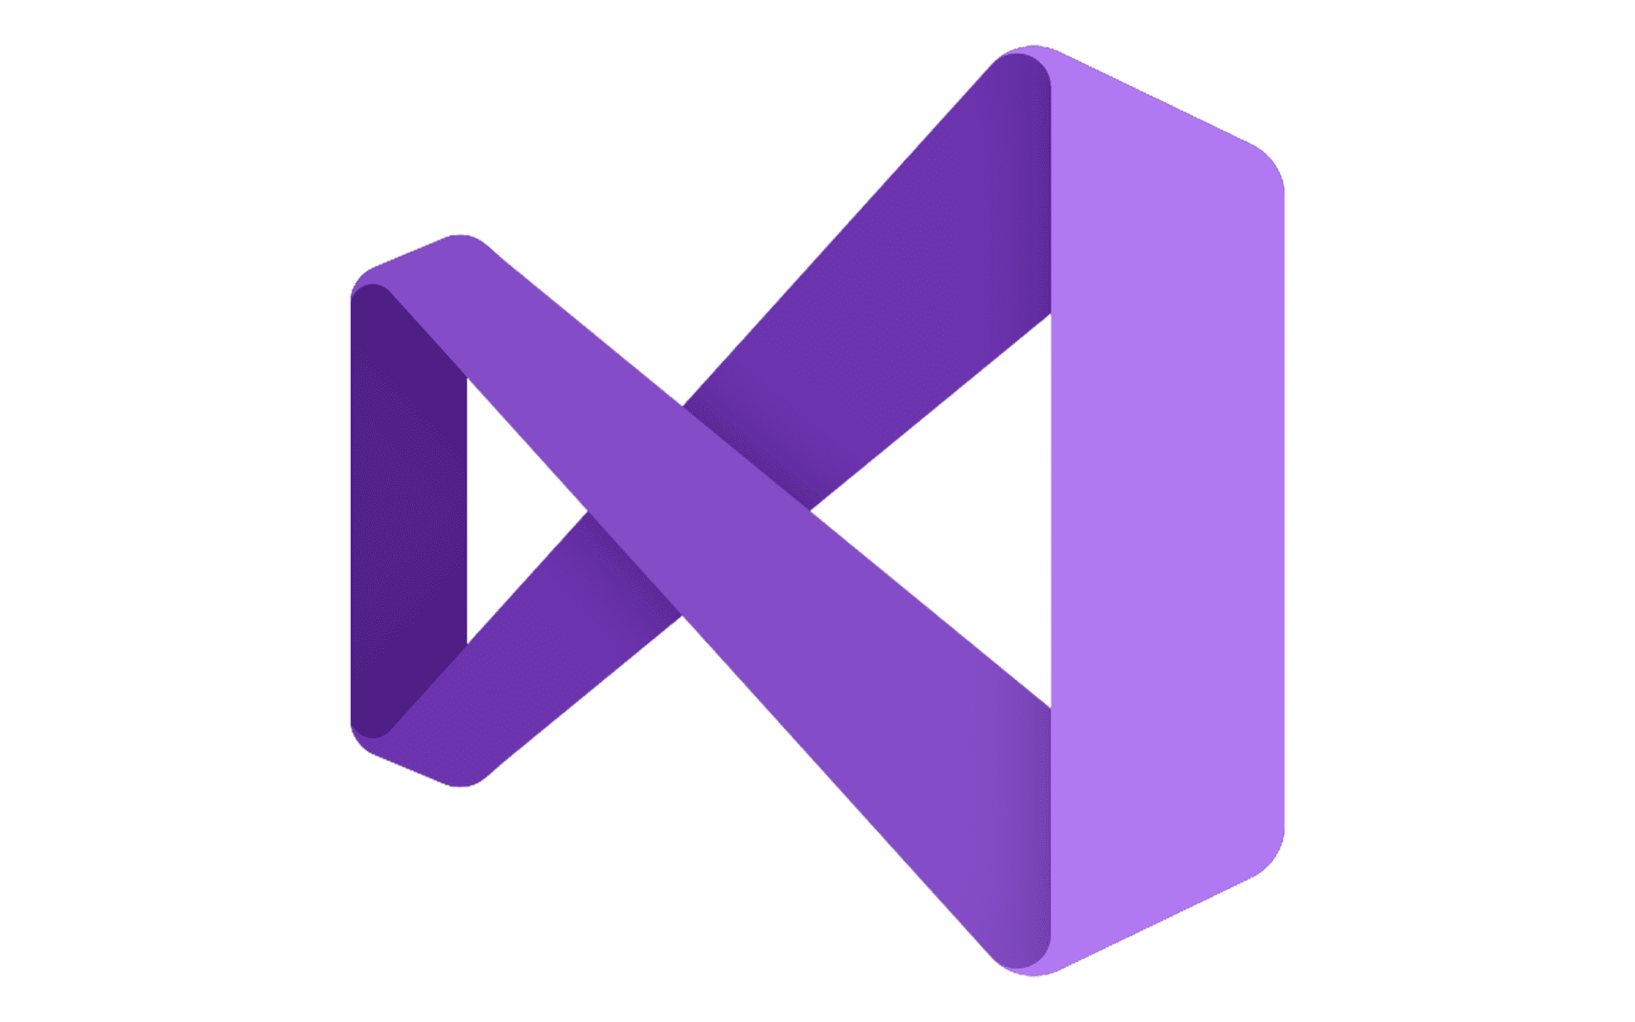

Build agents, your way
Transform any business process with low-code to pro-code tools
Copilot Studio
Visual Studio
GitHub
Microsoft empowers all users to build agents with tools across the developer spectrum
Notes:
Speaker notes: Only Microsoft can enable customers to build their agents the way they want. To transform their business processes—whether driven by individual users or organizational teams—they need flexibility in how they approach it.And Microsoft is uniquely positioned with the tools across the spectrum to empower both their technically skilled developers and the non-technically skilled users to build agents and build them fast!
Source: Azure AI Agent Service L300 Pitch Deck (link not available)

Slide 8


Agents from both sides can seamlessly connect
Agent
Agent
and work together
Copilot Studio
Visual Studio + GitHub
1-click publish to 15+ internal & external channels
Channels
Publish to 15+ channels via M365 Agents SDK
Connected Agent
Multi-Agent Orchestration
Multi-agent workflow, Connected Agent, Agent Framework
Built-in Memory
Memory and Threads
Built-in or BYO with Cosmos DB
Prebuilt actions + Custom Plugin Actions
Actions
Action Tools
Logic Apps, Functions, OpenAPI, MCP
Knowledge Tools
Azure AI Search, Bing, Fabric, SharePoint
Knowledge
Knowledge Tools
Azure AI Search, Bing, Fabric, SharePoint
Default Prebuilt Orchestrator
Tool Orchestrator
Foundry Agent Service
Foundry Models
Foundational Models
Foundry Models
Notes:
Speaker notes: And the good news is, regardless of how they build those agents, they’re all backed by Microsoft Foundry and the full stack that Microsoft offers.
Source: Azure AI Agent Service L300 Pitch Deck (link not available)

Slide 9









Microsoft Foundry
Microsoft Foundry
Foundry Models
Cloud
Copilot Studio
Azure
Visual Studio
Foundry Agent Service
Azure Arc
GitHub
Azure AI
Search
Azure AI
Services
Azure
Machine Learning
Azure AI
Content Safety
Foundry Local
Foundry SDK
Foundry Observability
Edge
Security • Identity • Management
Control
Azure Kubernetes Service
Azure App Service
Azure Container Apps
Azure Functions
Serverless
Notes:
Speaker notes: Microsoft Foundry is a flexible, secure platform of services that empowers enterprises, start-ups and software developer companies to create the future of AI. Use developer tools they already know – GitHub, Visual Studio, and Copilot Studio - to build powerful solutions that can optimize call center performance, analyze data, improve product discovery, validate code, automate workflows, and more. Microsoft Foundry brings models, agents, tools, and more into one unified experience. They can access services through a developer-friendly portal, unified SDK, and APIs. Ship faster with quick-start templates. Deploy models to run anywhere. Experiment with continuous feedback loops. Scale to deliver agents that optimize workflows with confidence. With their models, pipelines, and agents ready, it’s time to deploy. Every app and agent needs a runtime. We offer options from serverless (Azure Functions, Container Apps) to full control with AKS—so they can match any price-performance need.
We’re simplifying deployment across compute environments.
New Integrations:
Container Apps + Foundry: Deploy models directly from the Foundry catalog.
Functions + Foundry: Build event-driven apps and agents with low overhead.
Kubernetes: Easier deployment of open-source AI models across cloud and hybrid.
Source: Azure AI Agent Service L300 Pitch Deck (link not available)

Slide 10






















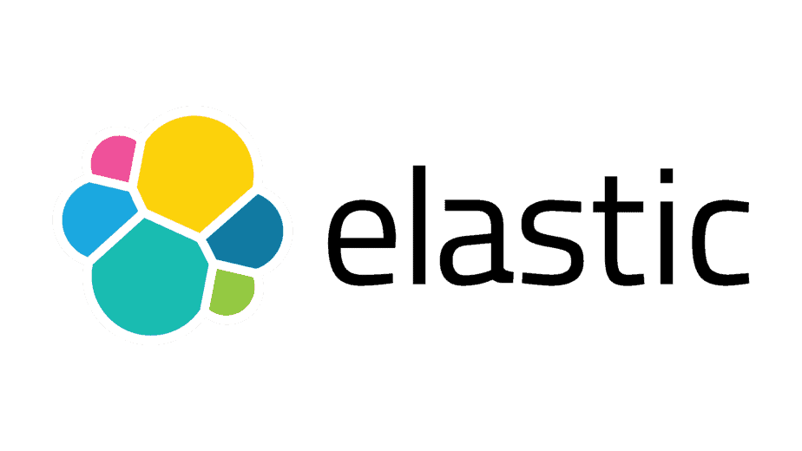



Microsoft Foundry
AI Agent Ecosystem
Authoring Tools
Foundry Models
Visual Studio
Azure Direct Models
OpenAI
Llama
Grok
GitHub
Flux
Mistral
Knowledge
Azure Ecosystem Models
Microsoft Fabric
Agent catalog
Ready-made agents to kickstart your agent workforce
Industry Models
Cohere
Paige
Azure Cosmos DB
Stability
Hugging Face
Phi
SharePoint
Foundry Labs
Agent frameworks
Client SDKs for enterprise and production agentic systems
Microsoft Graph
Muse
Magentic-One
Azure AI Search
Aurora
OmniParser
Agent tools
Orchestration
Channels
Microsoft Bing
Open Ecosystem
Enterprise Trust
Foundry Agent Service
Deploy and manage agents with fully-managed runtime
Protocols
A2A
MCP
OpenAPI
VNet deployments
Connectors
OBO Auth
Multi-agent workflows
Built-in threads
Long-term memory
Google VertexAI
Amazon Bedrock
CrewAI
LangChain
BYO-resources
ElasticSearch
Pinecone
Evaluation
Tracing & Monitoring
Governance + Safety
Managed Identities
Logic Apps
Azure Functions
Notes:
<Coach>: This slide is meant only to show the agent factory ecosystem. Don’t explain the slide in detail. The goal is to appreciate the rich ecosystem of services and tools available in the Foundry environment.
Source: Azure AI Agent Service L300 Pitch Deck (link not available)

Slide 11



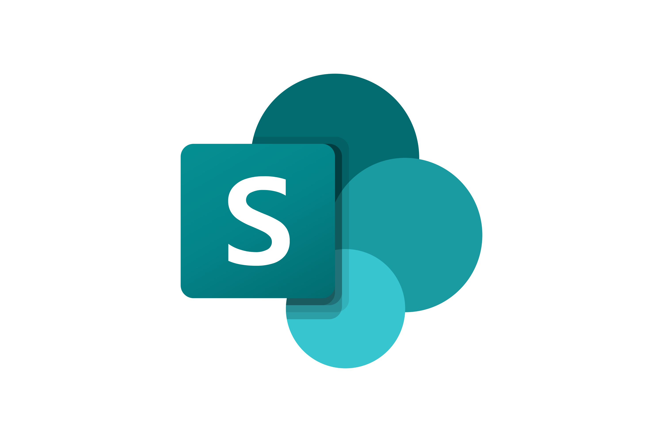









Microsoft Foundry Agent Service
Securely customize, orchestrate, and deploy AI agents
Model choice
AI tools
Trust
Model choice and flexibility with the model catalog
Richest set of enterprise connectivity
Customer control over data, networking, and security
Azure OpenAI Service
o1, o3-mini, GPT-4.1, 4o, etc.
Knowledge
BYO-file storage
BYO-search index
BYO-virtual network
BYO-thread storage
OBO authentication
Content filtering
Llama 3.1-405B-Instruct
Mistral Large
Cohere-Command-R-Plus
Actions
Logic Apps
Azure Functions
OpenAPI
MCP
Notes:
Speaker notes: In our experience talking to hundreds of organizations, we’ve learned that developing secure, reliable agents rapidly requires four primary ingredients:
Rapidly develop and automate processes: Agents need to seamlessly integrate with the right tools, systems and APIs to perform deterministic or non-deterministic actions.
Integrate with extensive memory and knowledge connectors: Agents need to manage conversation state and connect with internal and external knowledge sources to have the right context to complete a process.
Flexible model choice: Agents built with the appropriate model for its task can enable better integration of information from multiple data types, yield better results for task-specific scenarios, and improve cost efficiencies in scaled agent deployments.
Built-in enterprise readiness: Agents need to be able to:
support an organization's unique data privacy and compliance needs,
scale with an organization's needs,
complete tasks reliably and with high quality.
Source: Azure AI Agent Service L300 Pitch Deck (link not available)
.

Slide 12
Foundry Agent Service works with top agent protocols
Import external agents
Expose your agent externally
Assistants API
Assistants API
Responses API*
Responses API✧
Activity protocol*
Activity protocol✧
Microsoft Foundry
A2A*
A2A
Agent protocol✧
Agent protocol✧
MCP*
MCP*
* Available with Microsoft Agent Framework ✧ Coming soon
Notes:
Speaker notes: Customers can bring their own LLM to Foundry Agent Service (from any cloud)​. Foundry Agent Service further strengthens this vision by supporting open protocols like Agent-to-Agent (A2A) and Model Context Protocol (MCP), ensuring seamless interoperability across agent frameworks and ecosystems while maintaining fine-grained control over orchestration and execution.
Source: Azure AI Agent Service L300 Pitch Deck (link not available)

Slide 13
Multi-agent orchestration

Slide 14
Multi-agent orchestration patterns
Hierarchical
Network
Maker-Checker
worker
reviewer
Supervisor
Hand-Off
Custom
Notes:
Speaker notes: Why multi-agent orchestration? As AI solutions become more sophisticated, a single agent is often not enough to handle all tasks or workflows.
Multi-agent orchestration enables collaboration between specialized agents, each handling different responsibilities, to achieve more robust and flexible automation.
Common Orchestration Patterns:
Hierarchical: Agents are organized in a hierarchy, where higher-level agents delegate tasks to lower-level agents and aggregate results. This pattern is useful for structured workflows with clear lines of responsibility.
Network: Agents communicate as peers in a network, sharing information and collaborating without a strict hierarchy. This pattern is ideal for scenarios requiring flexibility and dynamic task allocation.
Maker-Checker: One agent (the maker) performs a task, and another agent (the checker) reviews or validates the output. This pattern is commonly used for compliance, quality assurance, or risk management.
Worker/Reviewer/Supervisor: These roles mirror real-world team structures, where workers execute tasks, reviewers check the work, and supervisors oversee the process and make final decisions.
Hand-Off: Tasks are passed from one agent to another as they progress through different stages of a workflow, similar to an assembly line.
Custom: Organizations can design orchestration patterns tailored to their unique business processes and requirements.
Benefits of multi-agent orchestration:
Increases scalability and resilience by distributing tasks across multiple agents.
Enables specialization, where each agent can be optimized for a specific function.
Improves governance and traceability, as each step in the workflow can be monitored and audited.
Real-world Applications: Examples include
automated document processing,
customer service workflows,
fraud detection,
DevOps pipelines, where different agents handle intake, analysis, validation, and escalation.
Source: Azure AI Agent Service L300 Pitch Deck (link not available)

Slide 15
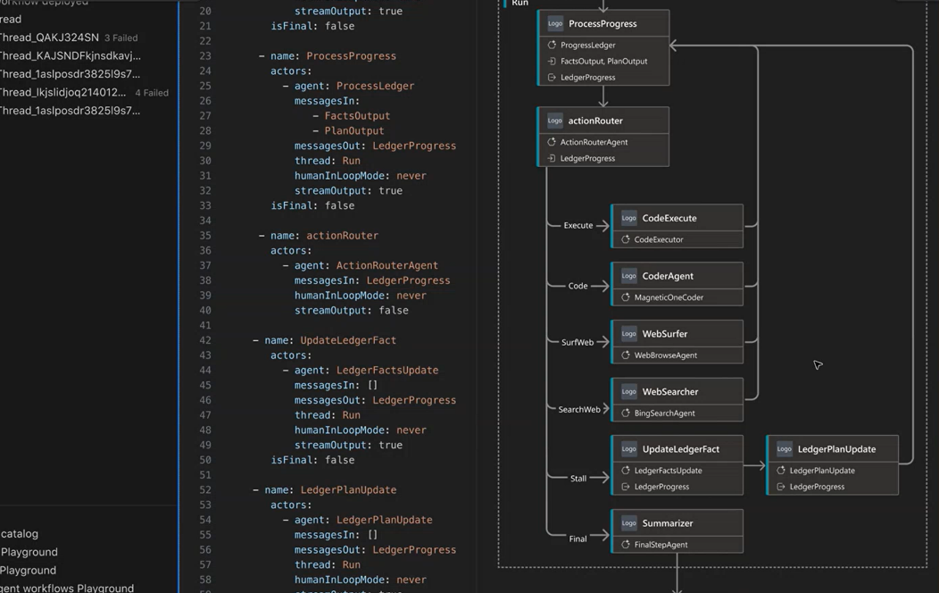
Multi-agent workflows
Empower developers to build multi-step, cross-agent logic with explicit transitions, state control, and structured data sharing
Offer server-managed persistence, enabling agents to:
Resume after a crash or scale event
Run for minutes, hours, or days
Track history, retries, and progress
Support rule-based or LLM-assisted transitions, offering traceable, testable, and governable flows
Notes:
Source: Azure AI Agent Service L300 Pitch Deck (link not available)

Slide 16


Model Context Protocol (MCP)
MCP (Model Context Protocol) is an open standard for connecting applications to LLMs. It acts like a USB-C port for AI: just as USB-C standardizes device connections, MCP standardizes how LLMs connect to data sources and tools.
Why Use MCP?
Build smarter agents and workflows
Enables LLMs to interact with external data and tools seamlessly.
Plug-and-play integrations
Access a growing library of pre-built connectors.
LLM provider flexibility
Easily switch between different LLM vendors without reworking integrations.
Security proven practices
Keep data secure and within your infrastructure using standardized protocols.
Your computer
Local Data Source 1
MCP Server A
MCP Protocol
Local Data Source 2
Host with MCP client
MCP Server B
MCP Protocol
Internet
MCP Protocol
Remote Service 3
MCP Server C
Web APIs
Notes:
Speaker notes: The Model Context Protocol (MCP) is designed to standardize how applications provide context to AI models. This ensures improved interactions and efficiency in multi-agent workflows. By using MCP, developers can improve communication between different AI components, enabling a more seamless integration of various data sources and tools.
Source: 04-Multi Agents with SK and Foundry.pptx
https://microsoft.sharepoint.com/:p:/r/teams/SDPInnovationMotion/_layouts/15/Doc.aspx?sourcedoc=%7B41516D30-1CA4-47D6-B61A-47DF9C149077%7D&file=04-Multi%20Agents%20with%20SK%20and%20Foundry.pptx&action=edit&mobileredirect=true&DefaultItemOpen=1&share=IQEwbVFBpBzWR7YaR9-cFJB3AWSMu6nW5yYurOXqYesqD70

Slide 17




Agent-to-Agent (A2A) protocol
Purpose: Enables AI agents from different vendors to collaborate seamlessly.
Open and interoperable: Built on HTTP, SSE, JSON-RPC; supports all modalities (text, audio, video).
Secure by design: Enterprise-grade authentication and authorization.
Flexible task handling: Supports both short and long-running tasks with real-time updates.
Agent discovery: Uses “Agent Cards” to advertise capabilities.
Collaboration: Agents exchange tasks, context, and artifacts.
Real-world use: Streamlines workflows like hiring by coordinating multiple agents.
Client Agent
Remote Agent
Secure collaboration
Task and state management
User experience negotiation
Capability discovery
Notes:
Source: 04-Multi Agents with SK and Foundry.pptx
https://microsoft.sharepoint.com/:p:/r/teams/SDPInnovationMotion/_layouts/15/Doc.aspx?sourcedoc=%7B41516D30-1CA4-47D6-B61A-47DF9C149077%7D&file=04-Multi%20Agents%20with%20SK%20and%20Foundry.pptx&action=edit&mobileredirect=true&DefaultItemOpen=1&share=IQEwbVFBpBzWR7YaR9-cFJB3AWSMu6nW5yYurOXqYesqD70

Slide 18
Discussion wrap up
What challenges might arise when integrating multiple agents and AI services?
Why is it important for organizations to have flexibility in choosing AI models for their agents, and how does this affect scalability and cost?
Describe a scenario where multi-agent orchestration and open protocols would be essential for solving a complex business problem.
Notes:
<Coach> Invite participants to come off mute or share in chat their answers to the questions on this slide.

Slide 19
Lab outline – day one complete
DAY ONE
DAY TWO
Exercise one
Deploy application resources
Exercise three
Extend the shopping assistant using the A2A protocol
Exercise four
Observe model utilization in Microsoft Foundry
Exercise two
Implement a multimodal AI shopping assistant
Exercise five
Agentic DevOps
Exercise six
AI-enhanced red teaming
Notes:
<Coach> Review with students the exercises they completed for day one and the exercises they will complete on day two:
Day 1 – Title(s) and lab main objective
Day 2 – Title(s) and lab main objective

Slide 20
Today’s exercises (exercises three and four)
Exercise three: Extend the shopping assistant using the A2A protocol – 40 minutes
Tasks:
Build an A2A Server​
Extend the Zava Product Manager application
Exercise four: Observe model utilization in Microsoft Foundry – 60 minutes
Tasks:
Review the Microsoft Foundry Application analytics dashboard​.
Trace operations in Microsoft Foundry​.
Monitoring in Microsoft Foundry.
Notes:
Speaker notes:
Present a roadmap of the exercises for the rest of the day.
Your goal is to present the “what,” the high-level goals and outcomes.
Coaches in the breakouts will present the detailed “why” and “how,” the specific instructions for completing the exercises.

Slide 21
Today’s exercises (exercises five and six)​
Exercise five: Agentic DevOps – 60 minutes
Tasks:
Automate container deployment via GitHub Actions workflow​.
Automate deployment of Microsoft Foundry agents.
Exercise six: AI-enhanced red teaming – 40 minutes
Tasks:
Create an AI Red Teaming Agent and baseline.​
Create custom attack prompts and strategies.
Notes:
Speaker notes:
Present a roadmap of the exercises for the rest of the day.
Your goal is to present the “what,” the high-level goals and outcomes.
Coaches in the breakouts will present the detailed “why” and “how,” the specific instructions for completing the exercises.

Slide 22
Exercise three
Extend the shopping assistant using the A2A protocol
Notes:
<Coach>
Introduce exercise three.
Begin by introducing the students to the lab environment and the associated GitHub IO page. Provide a walkthrough of the entire scenario, outlining the objectives, main tasks, and key activities they’ll be working on.
As you explain each element, emphasize its significance and how it connects to real-world situations. Help students understand not only what they’re doing but why it matters—highlighting how these tasks mirror the challenges and workflows they may find in professional settings.

Slide 23
Exercise three
overview Extend the shopping assistant using the A2A protocol
Scenario
In this exercise, we’ll use the Agent2Agent (A2A) Protocol to enable communication between multiple AI agents. This will allow us to create a more sophisticated shopping assistant that can leverage the strengths of different AI models and services.
Objective 1
Understand the A2A Protocol and its benefits​.
Objective 2
Implement A2A communication between multiple AI agents.
Notes:
<Coach guidance> Use the GitHub I/O pages to introduce the lab exercise and review the objectives to give the students the important “WHY” of what they’ll be doing.
Speaker notes:
In the previous exercise, you implemented a multimodal AI shopping assistant for Zava using Microsoft Foundry. The assistant allows customers to upload images and short videos, ask questions about the set of products available from Zava, and make purchases, all from a multimodal chat interface. However, Zava would like to extend the capabilities of the shopping assistant by integrating it with other AI services and tools. This integration will allow the assistant to provide more personalized recommendations, improve the accuracy of product searches, and enhance the overall customer experience.

Slide 24





Exercise three architecture
AI Search
App Service
Plan
Zava A2A Service
Server
Agent Executor
Product Manager agent
Marketing agent
Ranker agent
Inventory agent
App Service
Phi-4 Deployment
GPT-4o Deployment
Microsoft Foundry
Container
Registry
Storage
Account
Notes:
<Coach>
Review the architecture diagram for this lab.
Exercise three summary
In this exercise you:​
Built an Agent2Agent (A2A) Protocol server​
Created an Agent Card​
Extended the server with multiple agents

Slide 25
Exercise four
Observe model utilization in Microsoft Foundry​
Notes:
<Coach>
Introduce exercise four.
Begin by introducing the students to the lab environment and the associated GitHub IO page. Provide a walkthrough of the entire scenario, outlining the objectives, main tasks, and key activities they’ll be working on.
As you explain each element, emphasize its significance and how it connects to real-world situations. Help students understand not only what they’re doing but why it matters—highlighting how these tasks mirror the challenges and workflows they may find in professional settings.

Slide 26
Exercise four
overview Observe model utilization in Microsoft Foundry​
Scenario
In this exercise, you’ll learn how to use the observability features in Microsoft Foundry to monitor and trace the performance of your deployed AI models. You’ll explore the Foundry Application analytics dashboard, trace model requests and responses, and analyze telemetry data using Azure Application Insights.
Objective 1
Use the Microsoft Foundry Application analytics dashboard to monitor the performance of your AI models in real-time​.
Objective 2
Trace model requests and responses to diagnose issues​.
Objective 3
Use Azure Application Insights to collect and analyze telemetry data​.
Objective 4
Generate alerts based on model performance metrics.
Notes:
<Coach guidance> Use the GitHub I/O pages to introduce the lab exercise and review the objectives to give the students the important “WHY” of what they’ll be doing.
Speaker notes:
As you deploy AI models to production, it is important to monitor their performance and usage to ensure they are functioning as expected and to identify any potential issues. To assist with this, Microsoft Foundry provides built-in observability features that allow you to track model performance, usage metrics, and errors. In addition, Azure Monitor and Application Insights can be integrated with Microsoft Foundry to provide deeper insights into model behavior and application performance. This will help Zava ensure that their multimodal AI shopping assistant is reliable and performs well for their customers.

Slide 27



Exercise four architecture
AI Search
Cosmos DB
App Service
Plan
Zava agents
Router
Shopping Assistant (Cora)
Interior Design
Inventory
Customer Loyalty
App Service
Phi-4 Deployment
GPT-4o Deployment
Microsoft Foundry
Container
Registry
Storage
Account
Application
Insights
Log Analytics
Workspace
Notes:
<Coach>
Review the architecture diagram for this lab.
Exercise four summary
In this exercise you:​
Reviewed the Application analytics dashboard in Microsoft Foundry​
Enabled tracing capabilities in the multimodal shopping application​
Collected telemetry data using Application Insights​
Created a custom workbook for your application​
Generated an alert based on token utilization

Slide 28
Exercise three
Debrief Extend the shopping assistant using the A2A protocol
Debrief question #1
What strategies did you use to ensure effective communication and coordination between agents using the A2A Protocol?
Debrief question #2
How did extending the shopping assistant with additional agents improve the customer experience?
Debrief question #3
What would you recommend to further enhance the shopping assistant’s capabilities using agent-to-agent communication?
Notes:
<Coach> Use these discussion questions to engage students into discussing lab impressions and key takeaways.

Slide 29
Exercise four
Debrief Observe model utilization in Microsoft Foundry​
Debrief question #1
How did you use the observability features of Microsoft Foundry to monitor your deployed AI models?
Debrief question #2
What insights did you gain from analyzing the telemetry data?
Debrief question #3
What recommendations would you make to improve the observability of AI applications in future projects?
Notes:
<Coach> Use these discussion questions to engage students into discussing lab impressions and key takeaways.

Slide 30
Exercise five
Agentic DevOps
Notes:
<Coach>
Introduce exercise five.
Begin by introducing the students to the lab environment and the associated GitHub IO page. Provide a walkthrough of the entire scenario, outlining the objectives, main tasks, and key activities they’ll be working on.
As you explain each element, emphasize its significance and how it connects to real-world situations. Help students understand not only what they’re doing but why it matters—highlighting how these tasks mirror the challenges and workflows they may find in professional settings.

Slide 31
Exercise five
Debrief Agentic DevOps ​
Scenario
In this exercise, you’ll learn how to use GitHub Copilot to generate GitHub Actions workflows that automate the deployment of an Azure Container Registry and Microsoft Foundry agents. By the end of this exercise, you’ll have a solid understanding of how to use GitHub Actions to streamline your DevOps processes and improve the efficiency of your development workflow.
Objective 1
Use GitHub Copilot to generate a GitHub Actions workflow that deploys to an Azure Container Registry.​
Objective 2
Use GitHub Actions workflows to deploy Microsoft Foundry agents.
Notes:
<Coach guidance> Use the GitHub I/O pages to introduce the lab exercise and review the objectives to give the students the important “WHY” of what they’ll be doing.
Speaker notes:
In the previous exercises, you built and extended a multimodal AI shopping assistant using Microsoft Foundry and the Agent2Agent (A2A) Protocol. The assistant allows customers to upload images and short videos, ask questions about the set of products available from Zava, and make purchases, all from a multimodal chat interface. You also learned how to implement observability in Microsoft Foundry to monitor the performance and health of your AI applications. But these deployments and configurations were done manually.

Slide 32

Exercise five architecture
AI Search
Cosmos DB
App Service
Plan
Zava agents
Router
Shopping Assistant (Cora)
Interior Design
Inventory
Customer Loyalty
App Service
Phi-4 Deployment
GPT-4o Deployment
Microsoft Foundry
Container
Registry
Storage
Account
Application
Insights
Log Analytics
Workspace
GitHub
Notes:
<Coach>
Review the architecture diagram for this lab.
Exercise five summary
In this exercise you:​
Used GitHub Copilot to create a GitHub Actions workflow to deploy your application to an Azure Container Registry​
Created a series of GitHub Actions workflows to manage your Microsoft Foundry agents

Slide 33
Exercise six
AI-enhanced red teaming
Notes:
<Coach>
Introduce exercise six.
Begin by introducing the students to the lab environment and the associated GitHub IO page. Provide a walkthrough of the entire scenario, outlining the objectives, main tasks, and key activities they’ll be working on.
As you explain each element, emphasize its significance and how it connects to real-world situations. Help students understand not only what they’re doing but why it matters—highlighting how these tasks mirror the challenges and workflows they may find in professional settings.

Slide 34
Exercise six
Debrief AI-enhanced red teaming ​
Scenario
In this exercise, we’ll review the Azure AI Red Teaming agent and apply it to the Zava shopping assistant application.
Objective 1
Use the AI Red Teaming Agent to run automated scans against your AI models​.
Objective 2
Analyze scan results and identify potential vulnerabilities.​
Objective 3
Develop custom attack prompts and strategies for red teaming exercises.
Notes:
<Coach guidance> Use the GitHub I/O pages to introduce the lab exercise and review the objectives to give the students the important “WHY” of what they’ll be doing.
Speaker notes:
As AI models become more sophisticated and are integrated into various applications, it’s crucial to ensure their security and reliability. Red teaming is a proactive approach to identify vulnerabilities and weaknesses in AI systems by simulating real-world attacks and adversarial scenarios. By conducting red teaming exercises, organizations can uncover potential risks, assess the robustness of their AI models, and implement necessary safeguards to mitigate threats. This is especially important for Zava, as they want to ensure that their multimodal AI shopping assistant is secure and trustworthy for their customers.

Slide 35
Exercise six architecture
App Service
Plan
AI Search
Cosmos DB
Zava agents
Router
Shopping Assistant (Cora)
Interior Design
Inventory
Customer Loyalty
Red Teaming Agent
App Service
Phi-4 Deployment
GPT-4o Deployment
Microsoft Foundry
Container
Registry
Application
Insights
Log Analytics
Workspace
GitHub
Notes:
<Coach>
Review the architecture diagram for this lab.
Exercise six summary
In this exercise you:​
Developed a baseline using the Azure AI Red Teaming agent​
Created custom attack prompts for use in red teaming​
Extended the baseline using a variety of Easy and Moderate attack strategies

Slide 36
Exercise five
Debrief Agentic DevOps
Debrief question #1
Were there any challenges when creating a GitHub Actions workflow for deploying to the Azure Container Registry?
Debrief question #2
After automating the deployment of Microsoft Foundry agents, how do you validate that the deployments were successful, and the agents are functioning as expected?
Debrief question #3
What improvements or additional automations would you recommend for future AI application deployments?
Notes:
<Coach> Use these discussion questions to engage students into discussing lab impressions and key takeaways.
What did you learn from running the baseline AI Red Teaming Agent, and how did customizing the attack prompts change the outcomes?
How did GitHub Copilot help generate or refine your attack prompts? Was it helpful in identifying edge cases or gaps?
How did the automatic remediation feature contribute to system resilience, and what improvements would you suggest for future iterations?

Slide 37
Exercise six
Debrief AI-enhanced red teaming​
Debrief question #1
How does red teaming in the context of AI applications contribute to the security and reliability of the Zava shopping assistant?
Debrief question #2
After running automated scans with the Red Teaming Agent, how did you analyze the results and determine which issues required remediation?
Debrief question #3
What recommendations would you make to strengthen the security posture of AI applications in future projects?
Notes:
<Coach> Use these discussion questions to engage students into discussing lab impressions and key takeaways.
What did you learn from running the baseline AI Red Teaming Agent, and how did customizing the attack prompts change the outcomes?
How did GitHub Copilot assist in generating or refining your attack prompts? Was it helpful in identifying edge cases or gaps?
How did the automatic remediation feature contribute to system resilience, and what improvements would you suggest for future iterations?
Optional:
Which attack strategies were most effective or surprising, and what insights did they reveal about the assistant’s vulnerabilities?

Slide 38
Wrap up

Slide 39
Learning objectives review
1. Envision a technical architecture for agentic AI solutions based on customer needs and AI practices.
2. Develop secure and scalable AI systems that comply with responsible AI principles and protect sensitive business data.
In this workshop you have worked with a team to:
3. Apply agentic DevOps practices to accelerate software development and deployment using GitHub Copilot, GitHub Actions, and Azure CI/CD pipelines.
4. Design, build and debug agentic AI solutions (single agent, multi agent) using Agentic AI frameworks, Models, tools and integration technologies.
Notes:
<Coach> Review the learning objectives targeted in the workshop.

Slide 40



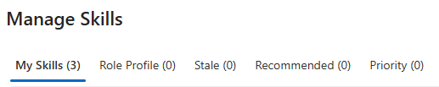

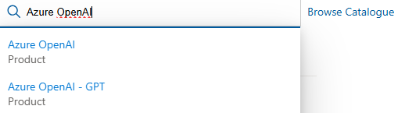





Skill maintenance
Call to Action
CSA Skills
CSAs are expected to update skills on a regular basis or when a change in Skill Proficiency occurs
Maintaining skills has many good reasons:
Tools and Processes rely on the skill inventory, i.e., for request/dispatch process
Skill planning aligned to customer demand and skill tracking for Readiness per area
Move from left to right in Skill Level: Foundational/Intermediate to Advanced/Expert
Available Skills (abstract):
Visit your Skill Workspace in Engage 360 Skills (microsoft.com) Default skills will be listed in your skill list
AI + ML | Analytics | Data
Azure OpenAI Agent Framework Document Intelligence Content Moderation Azure Machine Learning Azure AI Studio – Gen. AI Apps Azure AI Studio – AI SDK Azure Bot Services Azure Cognitive Search Azure Cognitive Speech and Translation Services Azure Cognitive Vision Services MLOps Mistral Inflection | Microsoft Fabric Data Integration and Orchestration Lakehouse, OneLake and Data Engineering Modernize Data Warehouse Real-time Analytics (Intelligence) Data Science, Generative AI and Copilots Azure Databricks Azure Data Factory | Azure Arc-Enabled Data Services Azure Cosmos DB for MongoDB vCore Azure Cosmos DB for NoSQL Azure Database for PostgreSQL Azure SQL Managed Instance
Select default skills, or browse the catalog for additional skills to Accept and add to your skill list
Choose or update the skill proficiency level for skills in skill list, according to your actual skills
In addition to your skills update, assure you are accredited to your technology specific VBDs!

Slide 41

Complete the evaluation
#57
Complete the evaluation survey.
This link is available in your Student guide, in the General chat, and you will also receive it via email.
Notes:
<Coach> Post the evaluation survey on the chat for students to complete: https://aka.ms/classeval.

Slide 42

Are you ready to up your game?
Become a coach!
Sign up here: Technical Mastery Workshops - Coach Recruiting
Program name – DELETE IF NO PROGRAM
Notes:
Speaker notes:
Invite students to become a Coach for future trainings.

Slide 43
Thank you
Notes:
<Coach guidance> Thank students for their attendance and engagement during the workshop.

